Slide 1
Identifying YouTube Spam Comments
Eddieb Sadat

Slide 2

Background
YouTube is one of the biggest media platforms (2 Billion + Monthly Active Users)_{[1]}
Spam comments make User Experience worse:
User interactions are flooded with unwanted messages
Users are vulnerable to scam messages
Backend flooded with data → expensive, potential downtime…
1 https://buffer.com/library/social-media-sites/

Slide 3



Motivation
Protect users, save costs, and create a better overall media products.
Can potentially be applied outside of YouTube.
Learn more about Natural Language Processing (NLP) and sklearn.
+
=

Slide 4
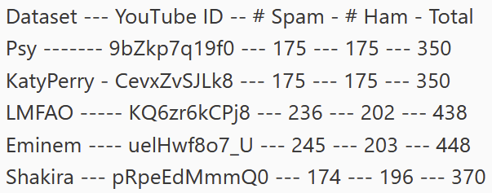

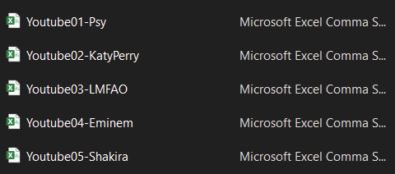

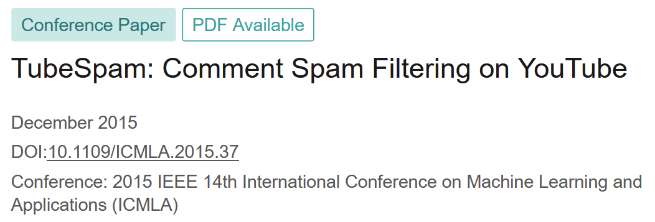
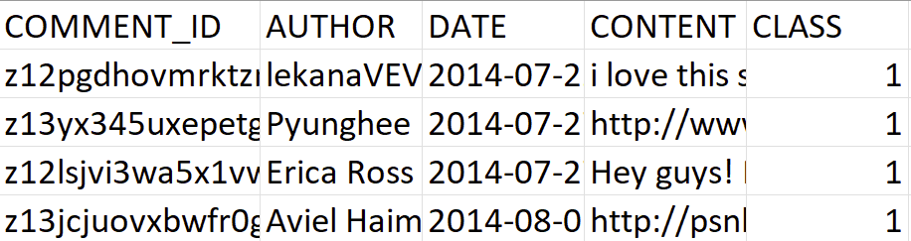
Data Description

Slide 5
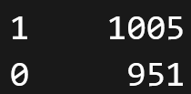
Data Preparation
Removed useless columns.
All five dataframes concatenated.
Check distribution of target class.
(Spam)
Looks healthy!
(Ham)

Slide 6
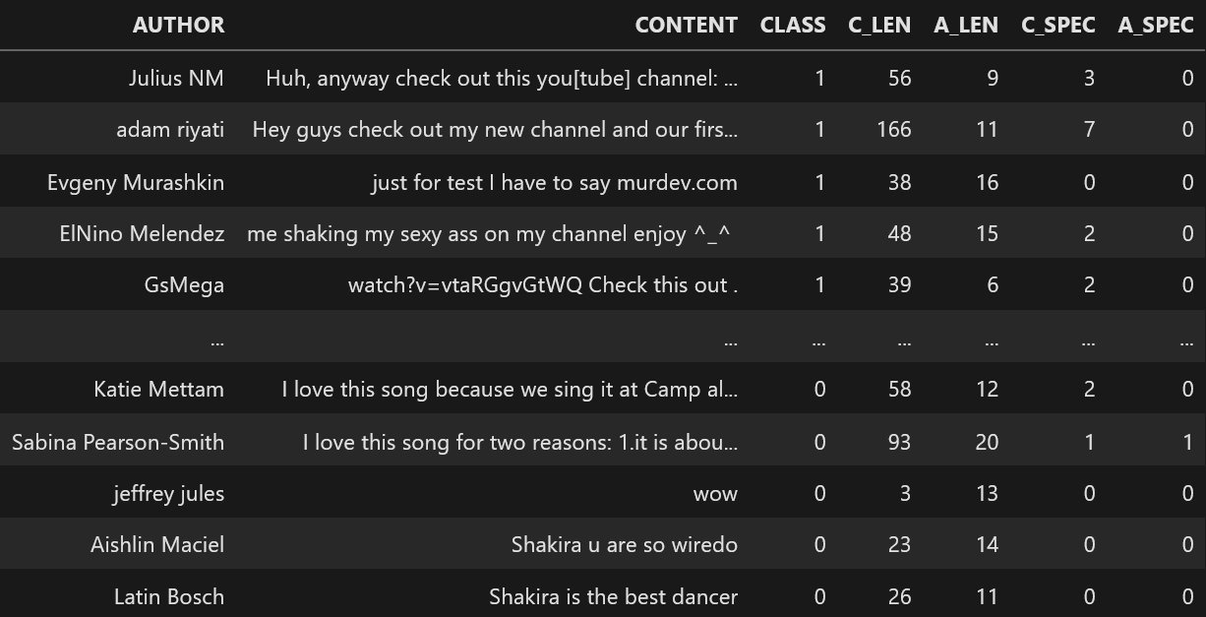
Modeling: Custom Parameters (no NLP)
Four new columns added:
Comment character length
Author Name character length
Comment number of special characters
Author Name number of special characters

Slide 7
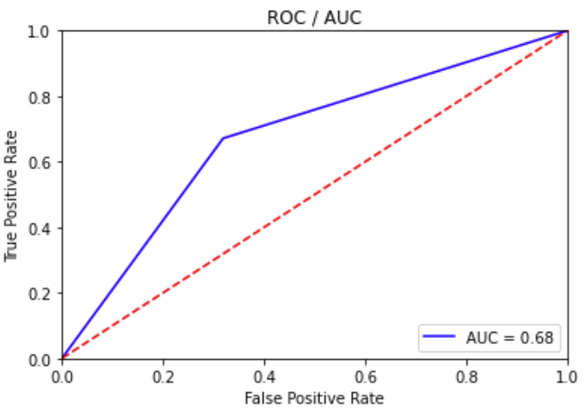
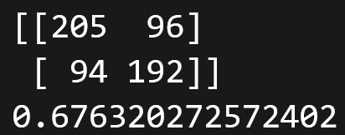
Three Prediction Models:
SVC (Support Vector Machine)
SGD (Stochastic Gradient Descent)
DecisionTree
Testing multiple parameters for each model with fixed random seed.
(139 total different combinations to check!)
Best Model: DecisionTree
(Confusion Matrix)
(Accuracy)

Slide 8
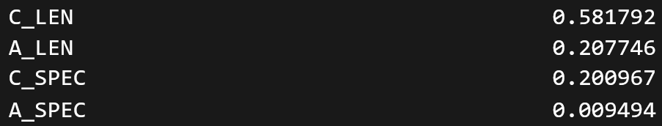
Best Model: DecisionTree
Importance of Each Attribute
NO CHANGE
Number of special characters in Author Name has very low importance. Delete!
(Confusion Matrix)
(Accuracy)

Slide 9
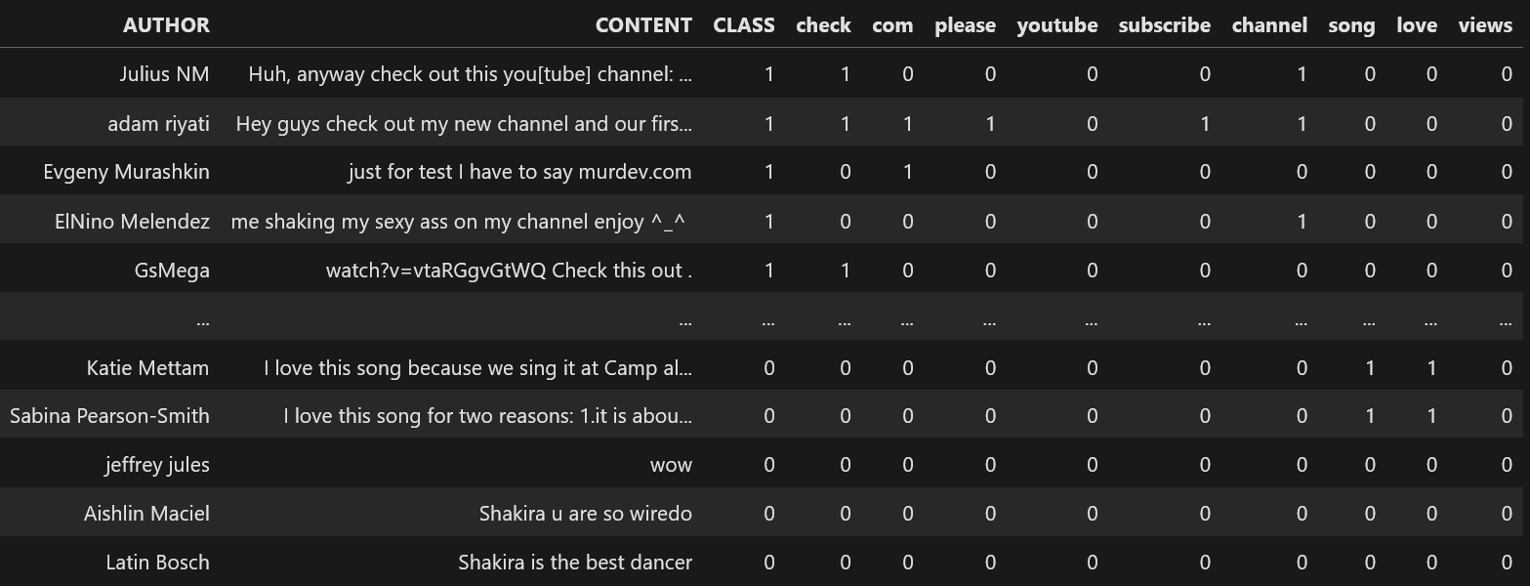
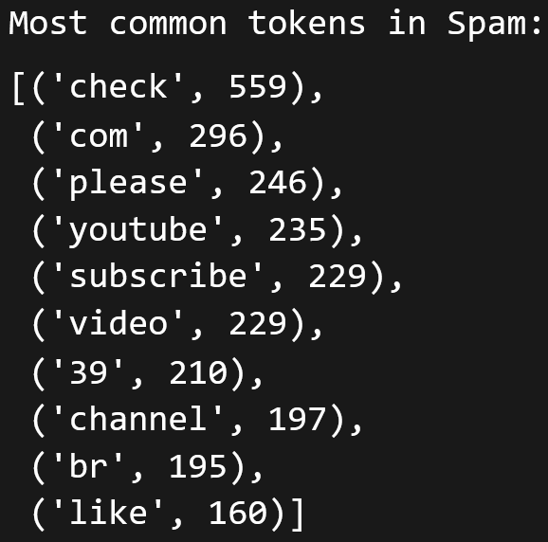
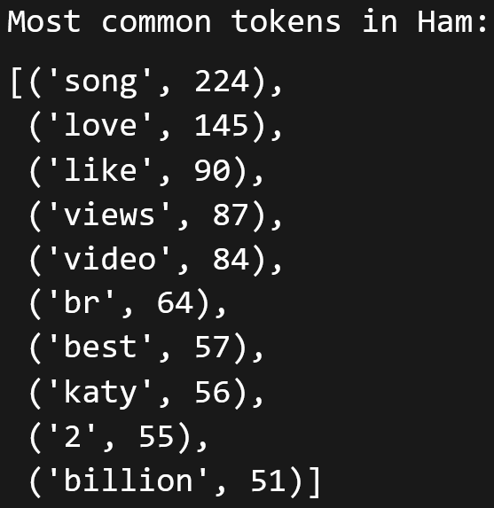
Modeling: NLP
Split data into Spam and Ham → Find the most frequent words in each.

Slide 10
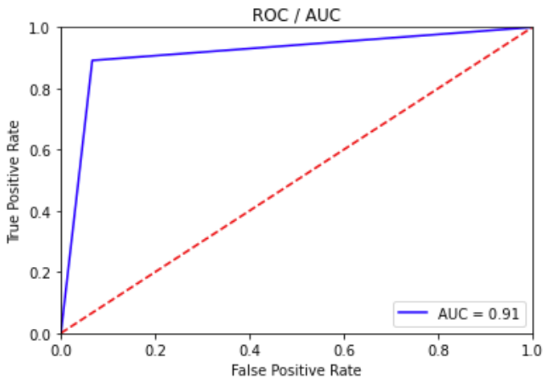

Three Prediction Models:
SVC (Support Vector Machine)
SGD (Stochastic Gradient Descent)
DecisionTree
Testing multiple parameters for each model with fixed random seed.
(139 total different combinations to check!)
Best Model: SVC (kernel = poly, C = 5)
(Confusion Matrix)
(Accuracy)

Slide 11
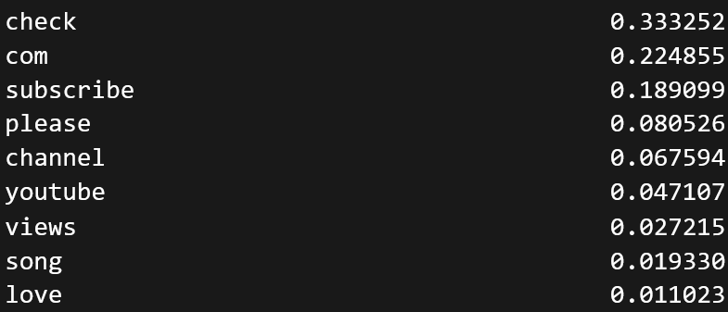
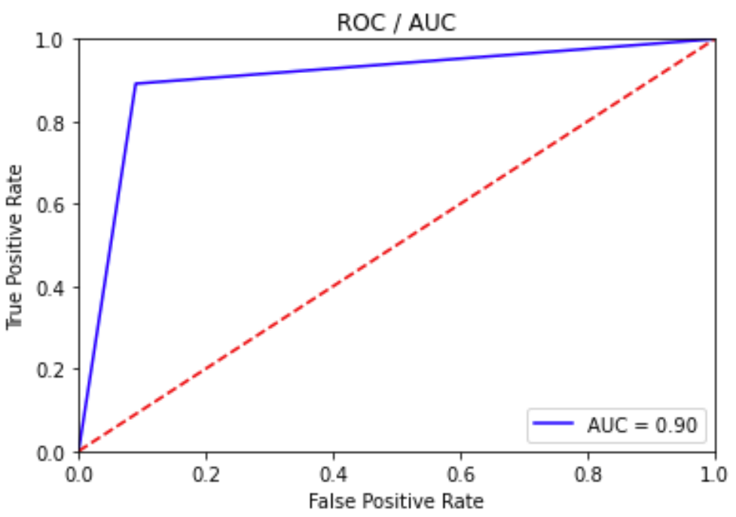
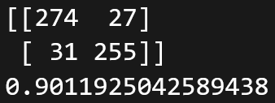
Importance of Each Attribute
Best Model: DecisionTree
WORSE RESULTS
(Confusion Matrix)
Remove last three.
(Accuracy)

Slide 12
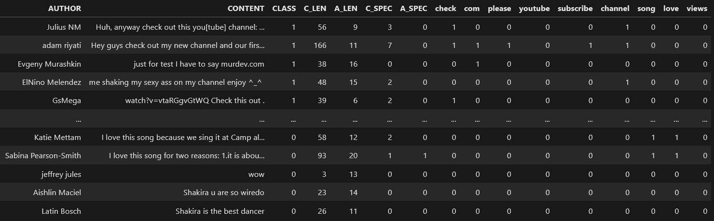
Modeling: Custom + NLP
Combining Custom with NLP

Slide 13
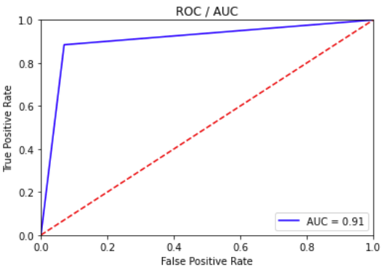

Three Prediction Models:
SVC (Support Vector Machine)
SGD (Stochastic Gradient Descent)
DecisionTree
Testing multiple parameters for each model with fixed random seed.
(139 total different combinations to check!)
Best Model: SVC (kernel = linear, C = 1)
(Confusion Matrix)
(Accuracy)

Slide 14
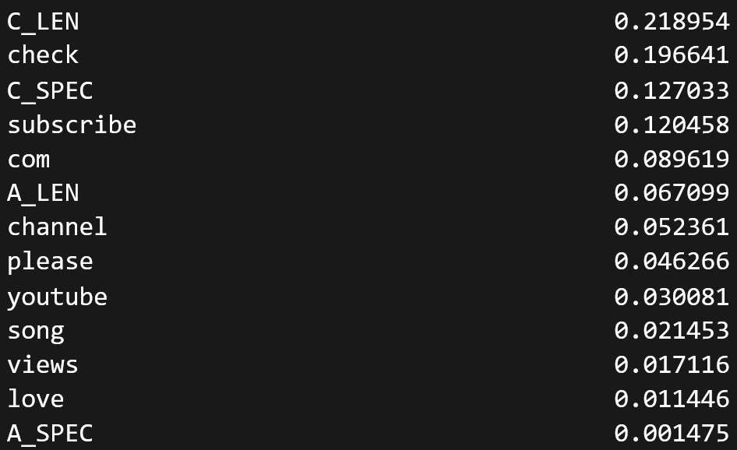

Importance of Each Attribute
Best Model: SVC (kernel = linear, C = 1)
WORSE RESULTS
Remove last four.
(Confusion Matrix)
(Accuracy)

Slide 15
Conclusion
The best model was produced by identifying whether or not the following words were present in the comments:
check, com, please, youtube, subscribe, channel, song, love, views
(Confusion Matrix)
(Accuracy)

Slide 16
Discussion
NLP is very important for spam identification.
SVP Linear takes a VERY long time with complex variables, especially with higher C values.
The current dataset only takes comments from the top 10 music videos as of 2015.
The model will likely perform considerably worse if tested on comments from other types of videos or from different dates.
Utilize video categories to build multiple models rather than one big one.

Slide 17
What questions do you have?

